Slide 1
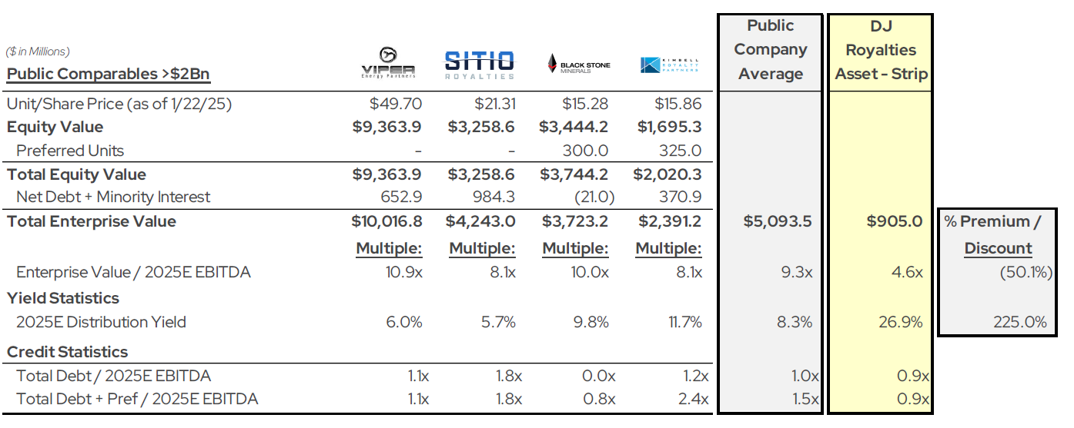
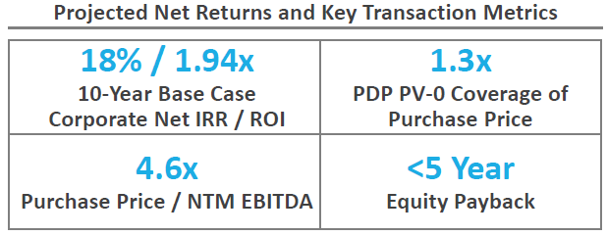
Executive Summary
Investment Background
Attractive Asset Relative to Public Comparable
GP is offering a $195 million co-investment opportunity (on a no fee, no carry to GP’s basis) for oil and gas royalty and mineral assets (referred to as “minerals” herein) alongside another fund that Fortitude has invested and the highly successful management team.
  The purchase and sale agreement (“PSA”) for the acquisition of the core DJ basin position (referred to as “DJ Royalties Asset” herein) has been signed and closing is anticipated on December 1st
  Co-Invest entity will be fully funded at close and anticipates making quarterly distributions from the co-invest entity starting with the Q3 2026 distribution, consistent with the Fortitude invested fund’s distribution cadence
The opportunity is a ~246k net royalty acre (“NRA”) package in the core of the DJ Basin, primarily operated by AA (~52% of the NAV) and BB (~22% of the NAV), who, together, are running ~40% of the basin’s total rigs and represent over 70% of the allocated NAV
  The acquisition, which represents 4.6x NTM multiple, is forecasted to generate a 10-year corporate net return of 18% IRR / 1.94x ROI at strip (upside case of 22% IRR / 2.31x ROI at $70 / $3.25 flat pricing)
  Projected average 5-year free cash flow yield of ~24% with equity payback in less than 5 years
Asset is highly diversified (no DSU makes up >3% of the purchase price) and has attractive downside protection (producing value (“PDP”) PV-0 / purchase price of 1.3x) and 10-year average levered free cash flow yield of ~19%

Slide 2
Investment Highlights
Scalable mineral asset with compelling underlying single-well operator economics and a strong combination of seasoned production and low-risk development from Drilled but Uncompleted Wells (“DUCs”), Permits and permits-in-process (“APDs”)
Robust downside protection provided through known reserve categories; PV-0 of PDP, DUCs & Permits results in 1.6x coverage of the purchase price
Substantial current cash flow provides immediate yield and is supported by high-confidence, near-term DUC and Permit inventory; average ten-year free cash flow yield of ~19%
Diversified position (no DSU is >3% of allocated value) with exposure to the most active operators in the basin (AA and BB are currently running 40% of basin rigs) and have publicly committed to long-term development
Material upside potential through improved resource recovery (via tighter spacing or type curve outperformance) and development timing
Base case underwriting ascribes minimal value to DSUs within 2,000’ setback rule; APDs de-risked through Comprehensive Area Plans, which have historically very high permit conversion rates

Slide 3
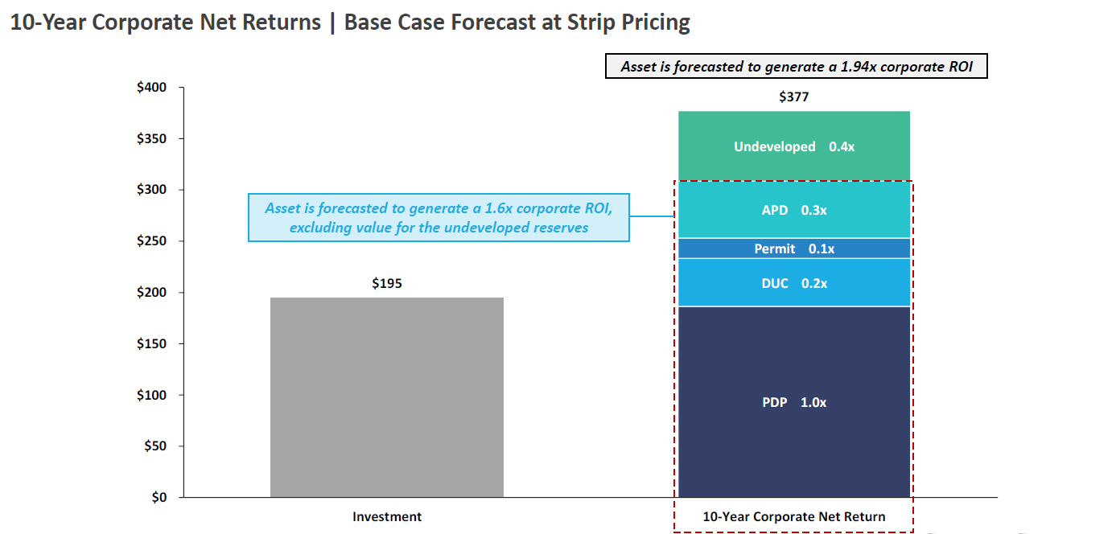
Co-Invest Equity Returns by Reserve Category

Slide 4
Basic Characteristics
Mature Production Profile: The DJ Basin has maintained ~1 MMBoe/d since mid-2018 and is
projected to maintain that level of production through 2029. The basin is a meaningful cash flow
driver for the in-basin public operators. Mature base production provides seasoned PDP and higher
confidence in long-term decline curves and reserves
Compelling operator economics: The combination of i) attractive single well rates of return and
ii) fast cycle times has resulted in optimized development that provides opportunity for operators to
compound capital efficiently while harvesting considerable free cash flow
Largely Consolidated: The basin went through several large mergers and acquisitions over the
past five years which has led to three large public companies holding an estimated ~95% of the sub-
$50 breakeven inventory
“Manufacturing Mode” Development: Roughly 85% of recent wells are co-completed
(compared to only 45% in the Bakken). DJ Basin operators have led the industry in modern drilling
and completion techniques. Since 2017, operators have developed ~2,200 Codell and ~5,600
Niobrara locations. The industry is currently moving to ~2-4 mile development to efficiently develop
the remaining resource

Slide 5
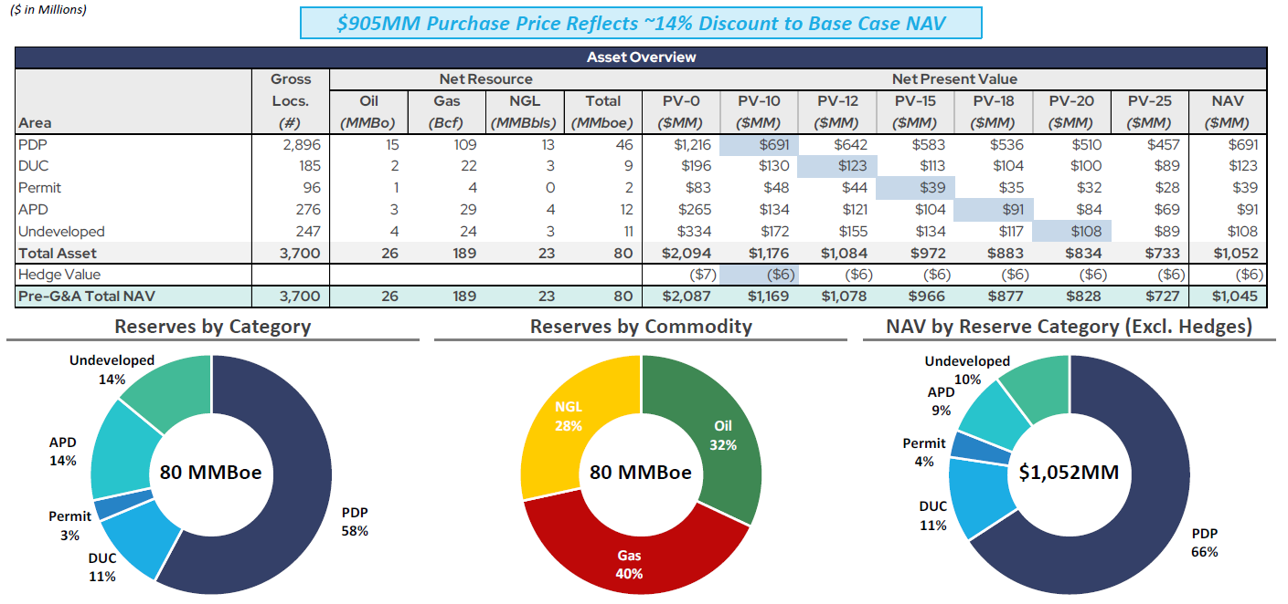
Asset Summary

Slide 6
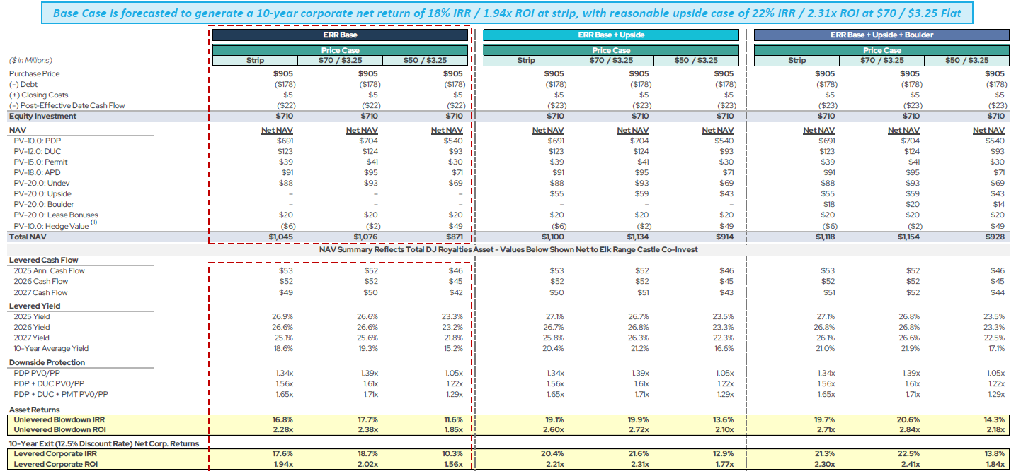
Projected Returns Summary

Slide 7
Co-Investment Structure
GP is offering a $195 million co-investment opportunity alongside a Fortitude Invested fund and the highly successful management team
The PSA for the acquisition of the DJ Royalties Asset has been signed, and closing is anticipated on December 1st
Co-investors will not be charged any management fees, nor will GP receive any carried interest with respect to the co-investment
Co-investment will be fully funded at close
Passive equity holder in a co-investment vehicle that will own a sharing ratio in an entity alongside a Fortitude Invested fund, which will own an undivided interest in the DJ Royalties Asset
GP will perform all management activities relating to the investment (exercise of approvals, voting, registration, etc.)
Co-investment vehicle will be subject to the GP’s Administrative Services Agreement for day-to-day management of the DJ Royalties Asset and an GP management incentive plan, which are included in net returns shown throughout. Administrative Services Agreement has the same economic terms as passive mineral investments with currently active GP’s portfolio companies. G&A reimbursement will be 75 bps of invested co-investor capital
Co-investment vehicle will be responsible for any incremental direct costs (audit, legal, tax, third-party services) and pro rata share of the fund costs

